Slide 1
CSC 2224: Parallel Computer Architecture and Programming GPU Architecture: Introduction
Prof. Gennady Pekhimenko
University of Toronto
Fall 2019
The content of this lecture is adapted from the slides of Kayvon Fatahalian (Stanford), Olivier Giroux and Luke Durant (Nvidia), Tor Aamodt (UBC) and Edited by: Serina Tan

Slide 2
https://www.youtube.com/watch?v=-P28LKWTzrI

Slide 3
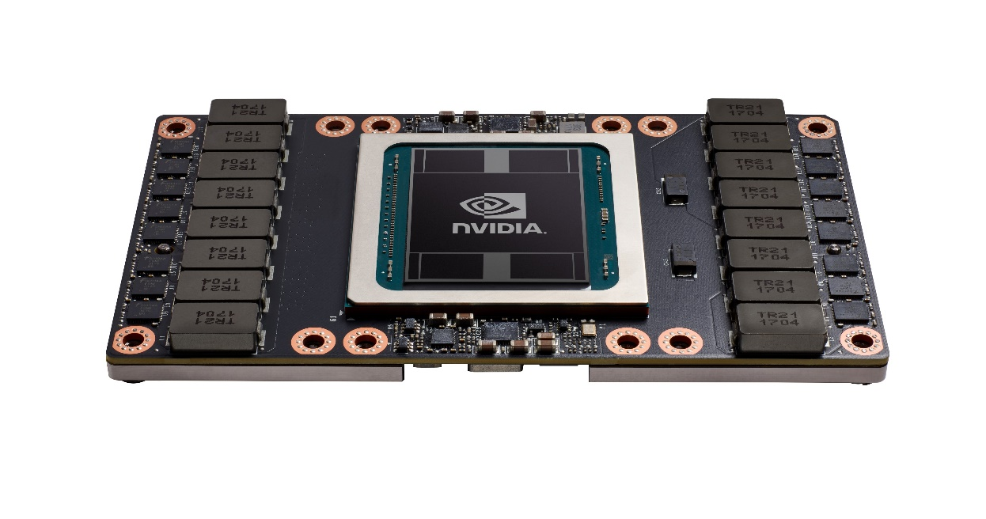
What is a GPU?
GPU = Graphics Processing Unit
Accelerator for raster based graphics (OpenGL, DirectX)
Highly programmable (Turing complete)
Commodity hardware
100’s of ALUs; 10’s of 1000s of concurrent threads
NVIDIA Volta: V100

Slide 4
The GPU is Ubiquitous
+
[APU13 keynote]

Slide 5
“Early” GPU History
1981: IBM PC Monochrome Display Adapter (2D)
1996: 3D graphics (e.g., 3dfx Voodoo)
1999: register combiner (NVIDIA GeForce 256)
2001: programmable shaders (NVIDIA GeForce 3)
2002: floating-point (ATI Radeon 9700)
2005: unified shaders (ATI R520 in Xbox 360)
2006: compute (NVIDIA GeForce 8800)
Notes:
GPGPU
Origins
Use in supercomputing
CUDA => OpenCL => C++AMP, OpenACC, others
Use in Smartphones (e.g., Imagination PowerVR)
Cars (e.g., NVIDIA DRIVE PX)

Slide 6
Why use a GPU for computing?
GPU uses larger fraction of silicon for computation than CPU.
At peak performance GPU uses order of magnitude less energy per operation than CPU.
GPU
200pJ/op
CPU
2nJ/op
Rewrite Application
Order of Magnitude More Energy Efficient
However….
Application must perform well

Slide 7
Agenda
Three key ideas that make GPUs run fast
GPU memory hierarchy
Closer look at a modern GPU architecture (Nvidia’s Volta)
Memory: higher bandwidth, larger capacity
Compute: application-specific hardware

Slide 8
Why GPUs Run Fast?
Three key ideas behind how modern GPU processing cores run code
Knowing these concepts will help you:
Understand GPU core designs
Optimize performance of your parallel programs
Gain intuition about what workloads might benefit from such a parallel architecture

Slide 9
Example Program: Vector Multiply-Add
Compute v = a ∙ b + c (a, b, c and v are vectors with a length of N)
a
𝘅
b
void mul_add (int N, float* a, float* b, float* c, float* v) {
for (int i = 0; i < N; i++) {
v[i] = a[i] * b[i] + c[i]
}
}
＋
c
=
v

Slide 10
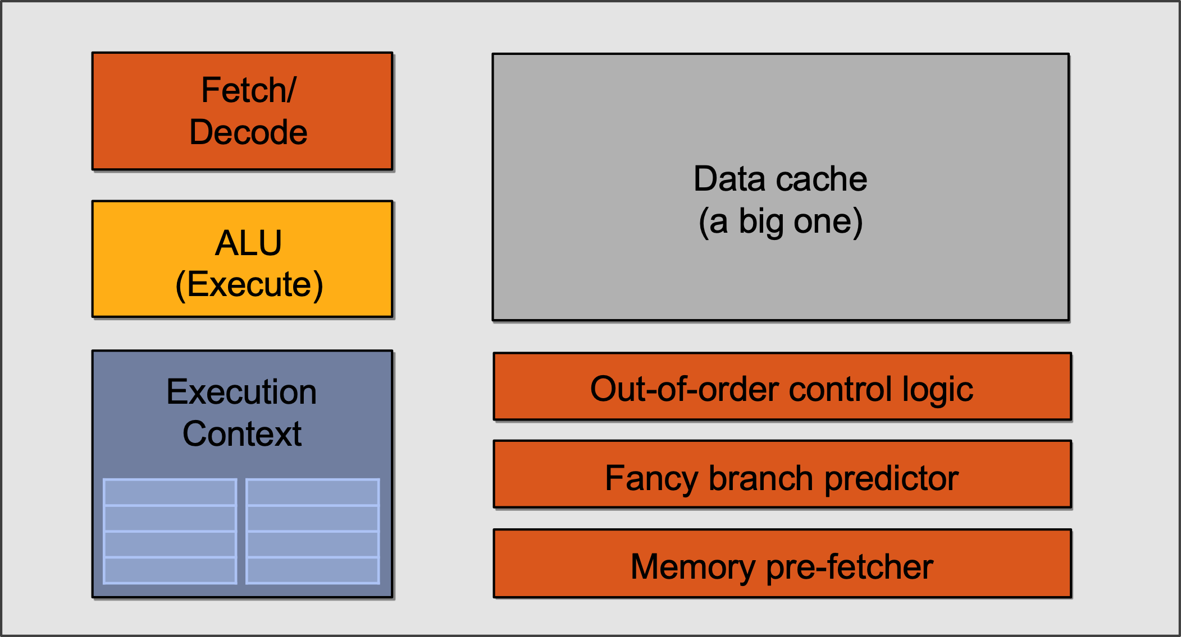
Single-core CPU Execution
mov R1, 0
START:
ld R2, a[R1]
ld R3, b[R1]
ld R4, c[R1]
madd R5, R2, R3, R4
st R5, v[R1]
add R1, R1, 1
bra START if R1 < N

Slide 11
Single-core CPU Execution
mov R1, 0
START:
ld R2, a[R1]
ld R3, b[R1]
ld R4, c[R1]
madd R5, R2, R3, R4
st R5, v[R1]
add R1, R1, 1
bra START if R1 < N
madd stalled,
jump to the next independent instruction
START:
ld R2, a[R1]
ld R3, b[R1]
ld R4, c[R1]
madd R5, R2, R3, R4
st R5, v[R1]
add R1, R1, 1
bra START if R1 < N
Can also be executed out-of-order through register renaming
…
Instruction Flow

Slide 12
Single-core CPU Execution
mov R1, 0
START:
ld R2, a[R1]
ld R3, b[R1]
ld R4, c[R1]
madd R5, R2, R3, R4
st R5, v[R1]
add R1, R1, 1
bra START if R1 < N
But what if we tell the hardware
these two blocks can be executed
in parallel to begin with?
START:
ld R2, a[R1]
ld R3, b[R1]
ld R4, c[R1]
madd R5, R2, R3, R4
st R5, v[R1]
add R1, R1, 1
bra START if R1 < N
…
Instruction Flow

Slide 13
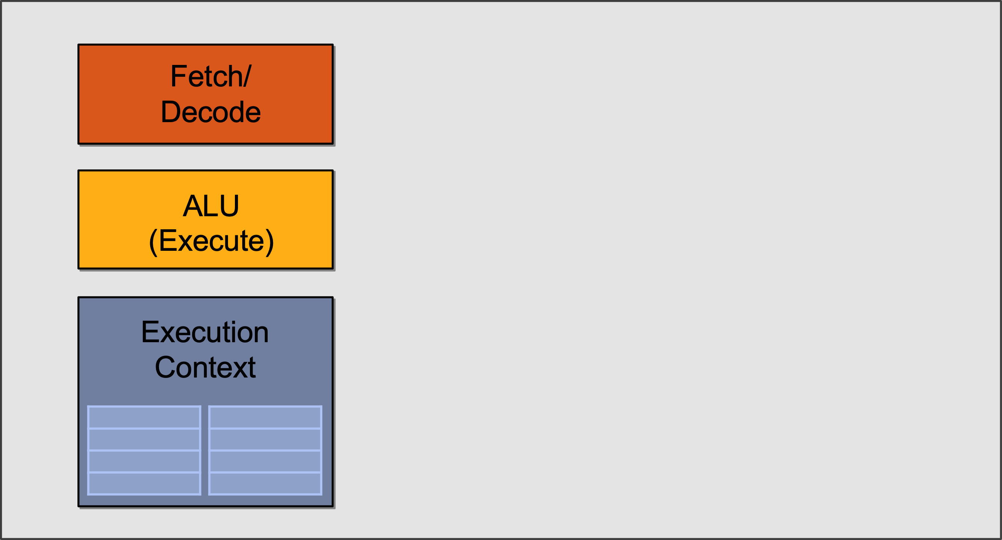
Slimming Down
Idea #1:
Use increasing transistor count to add more cores to the processor
… rather than use transistors to increase sophistication of processor logic that accelerates a single instruction stream (e.g., out-of-order and speculative operations)

Slide 14
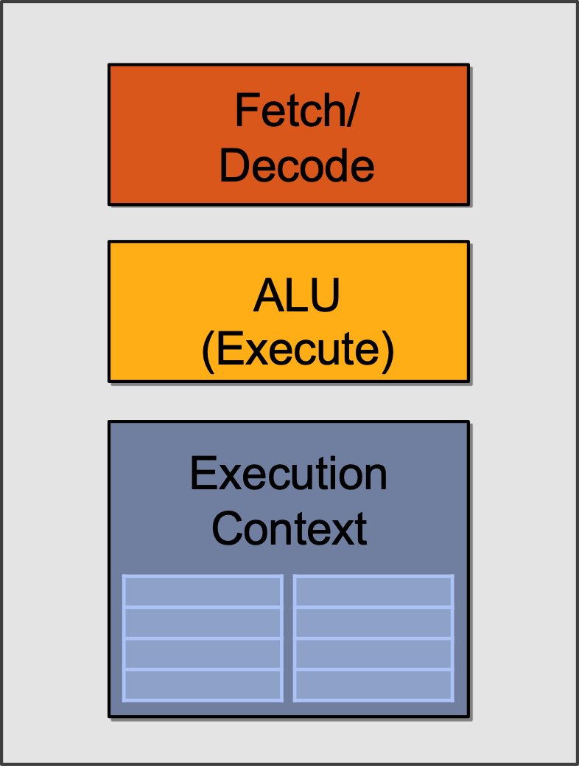
Two cores (Two Elements in Parallel)
Element x
Element y
START:
ld R2, a[R1]
ld R3, b[R1]
ld R4, c[R1]
madd R5, R2, R3, R4
st R5, v[R1]
add R1, R1, 1
START:
ld R2, a[R1]
ld R3, b[R1]
ld R4, c[R1]
madd R5, R2, R3, R4
st R5, v[R1]
add R1, R1, 1
Result x
Result y

Slide 15
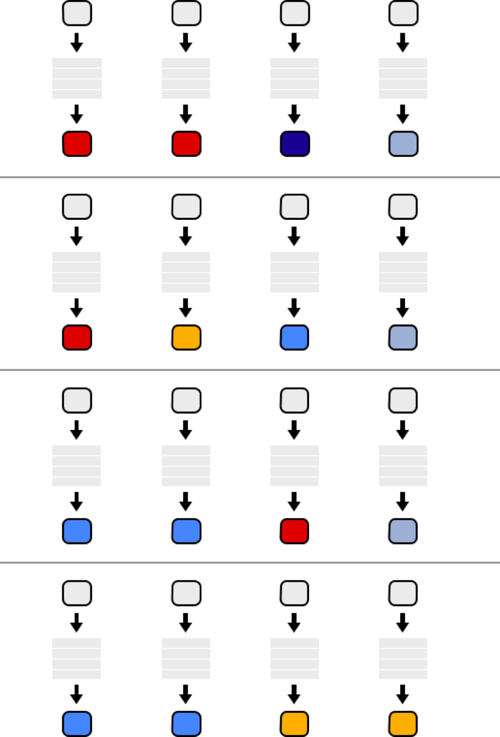
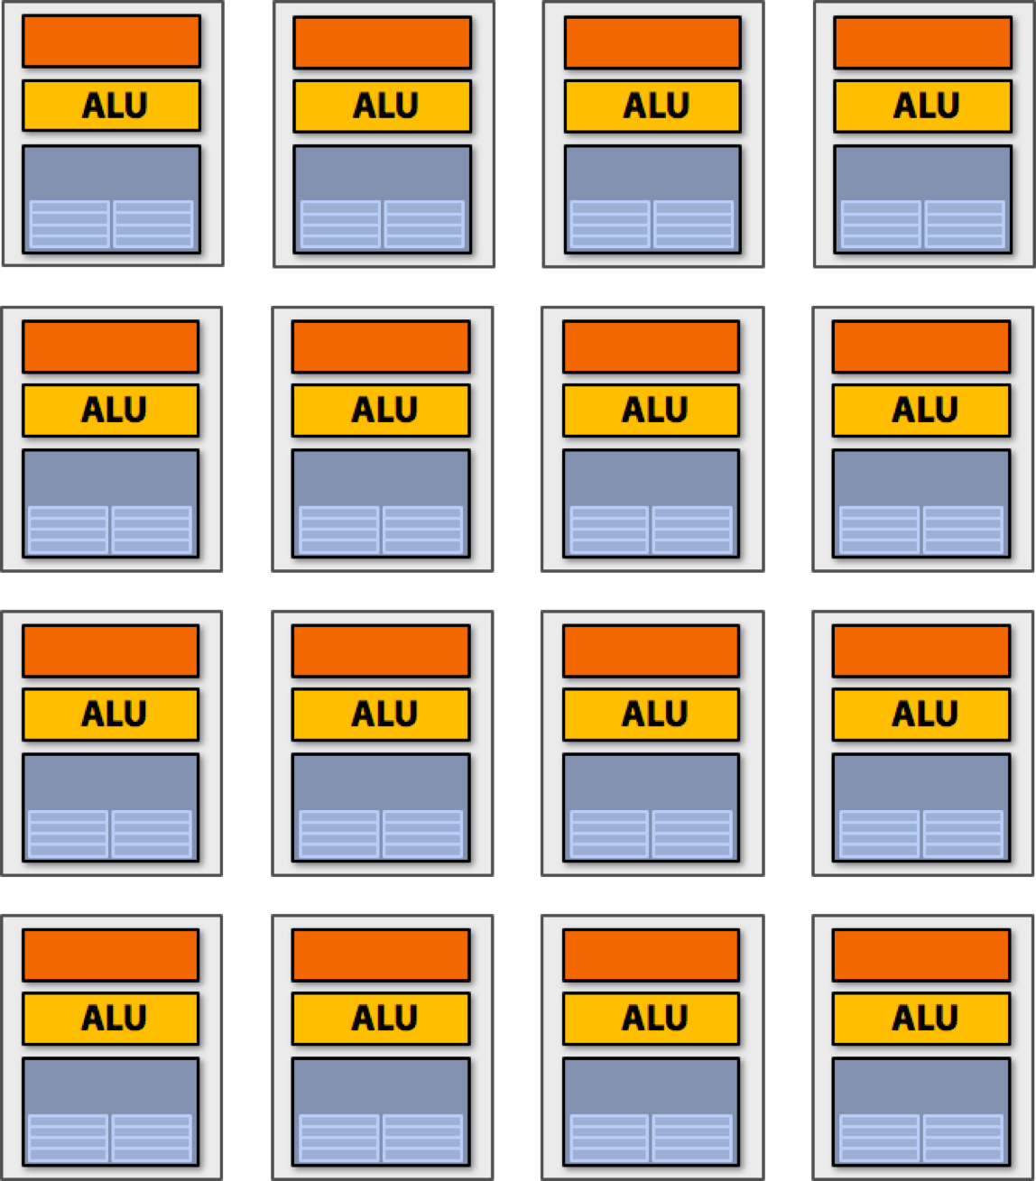
Sixteen Cores
But wait… Different elements in the vector
are running the exact same instructions!
START:
ld R2, a[R1]
ld R3, b[R1]
ld R4, c[R1]
madd R5, R2, R3, R4
st R5, v[R1]
add R1, R1, 1
16 cores = 16 simultaneous instruction streams

Slide 16
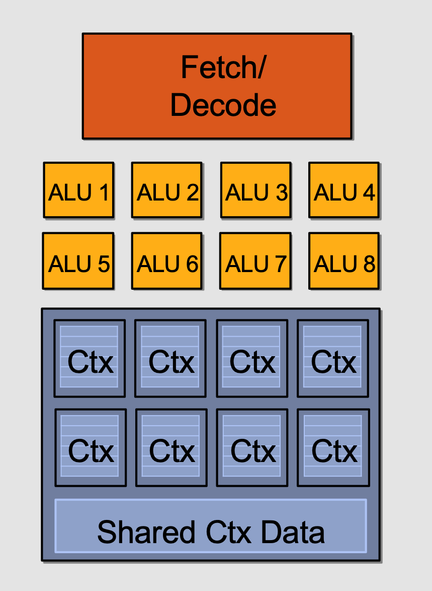
Instruction Stream Sharing
Idea #2:
Amortize cost/complexity of managing an instruction stream across many ALUs
SIMD processing!

Slide 17
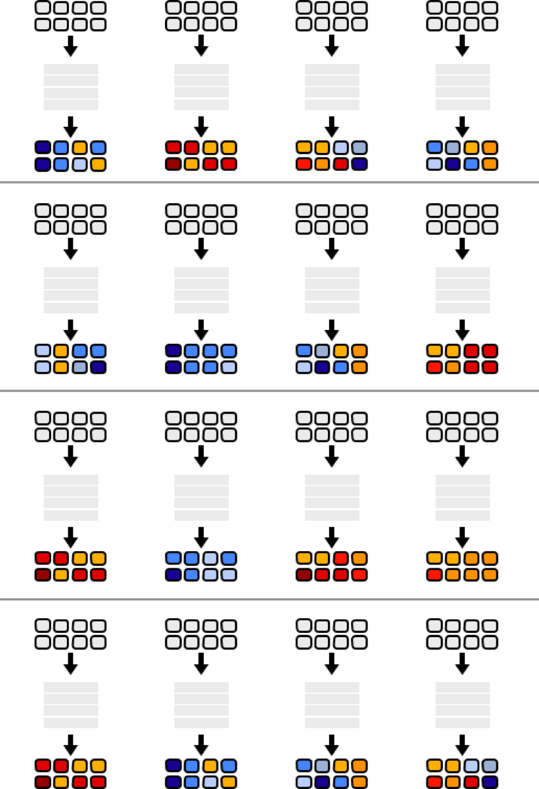
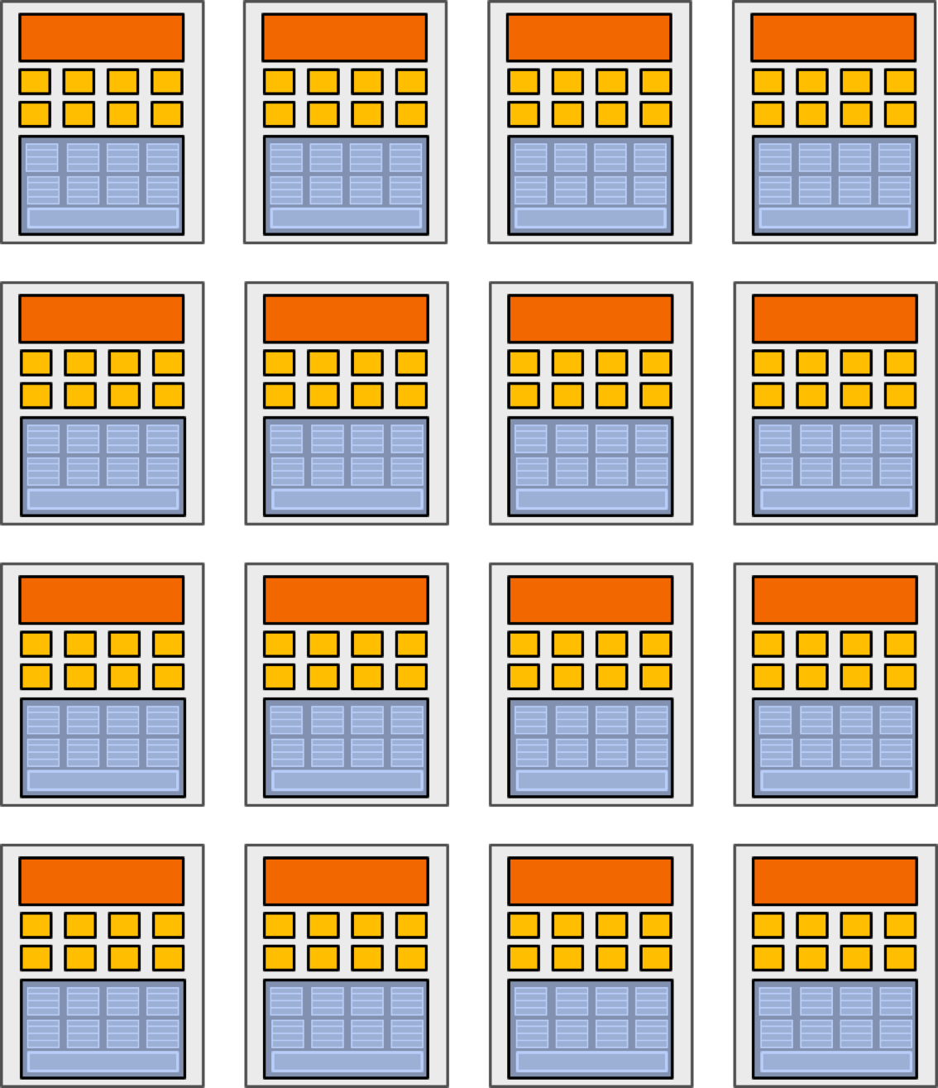
128 Elements in Parallel
16 cores 𝘅 8 ALUs/core = 128 ALUs
16 cores = 16 simultaneous instruction streams

Slide 18
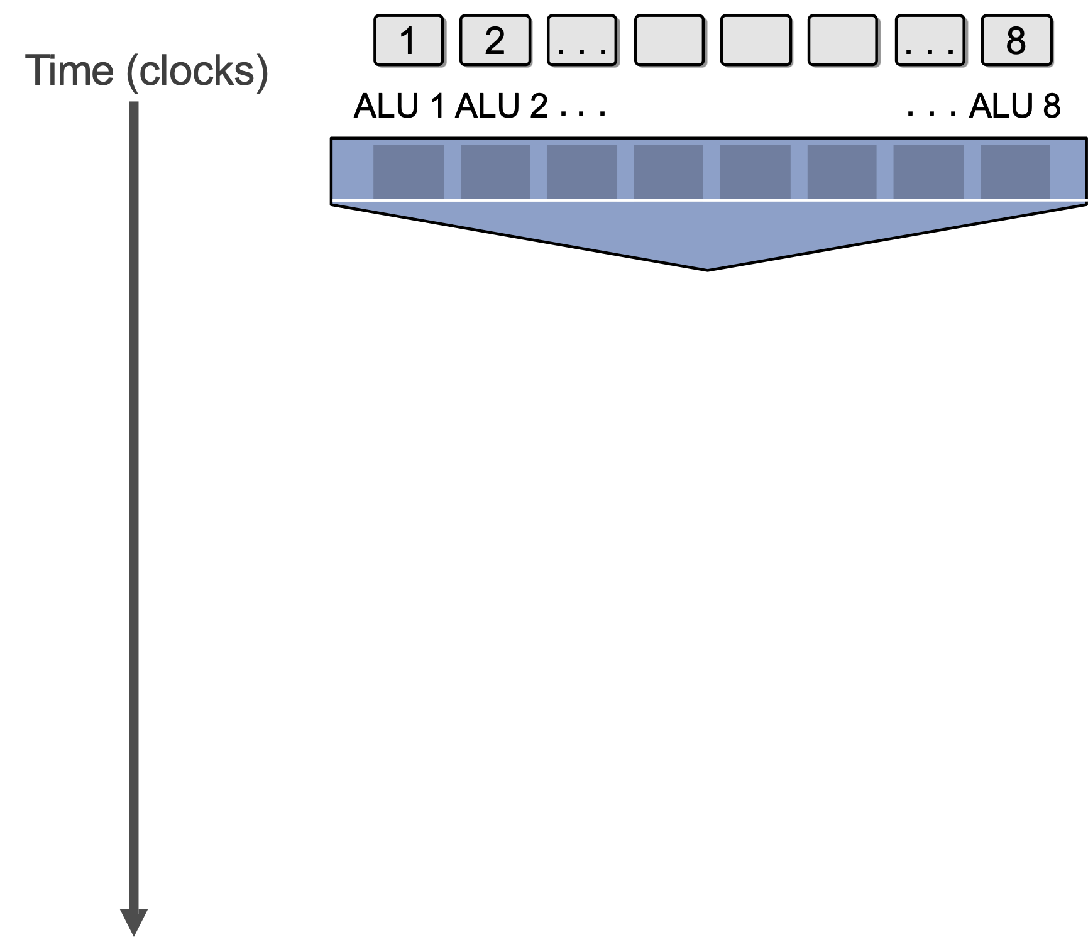
What about Branches?
<unconditional shader code>
if (x > 0) {
y = pow(x, exp);
y *= Ks;
refl = y + Ka;
} else {
x = 0;
refl = Ka;
}
<resume unconditional shader code>

Slide 19
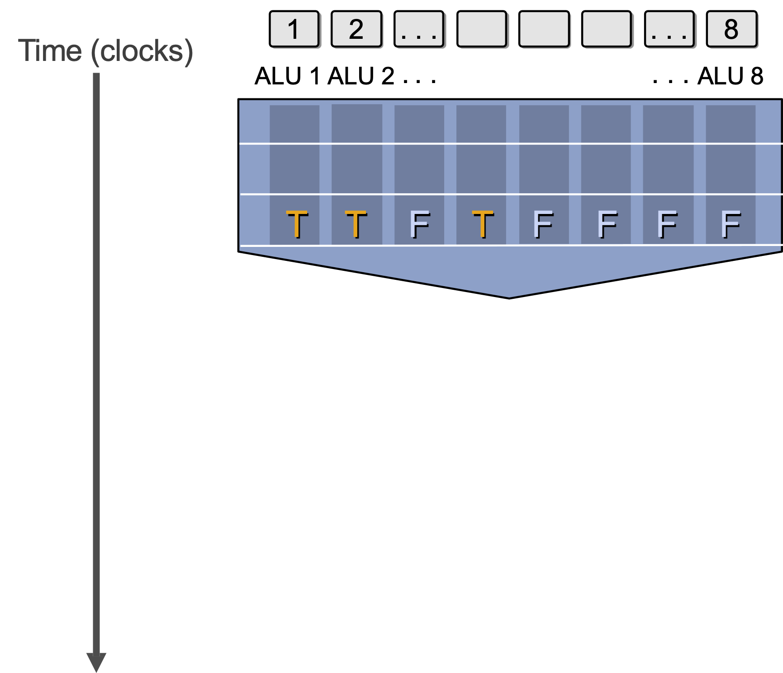
What about Branches?
<unconditional shader code>
if (x > 0) {
y = pow(x, exp);
y *= Ks;
refl = y + Ka;
} else {
x = 0;
refl = Ka;
}
<resume unconditional shader code>

Slide 20
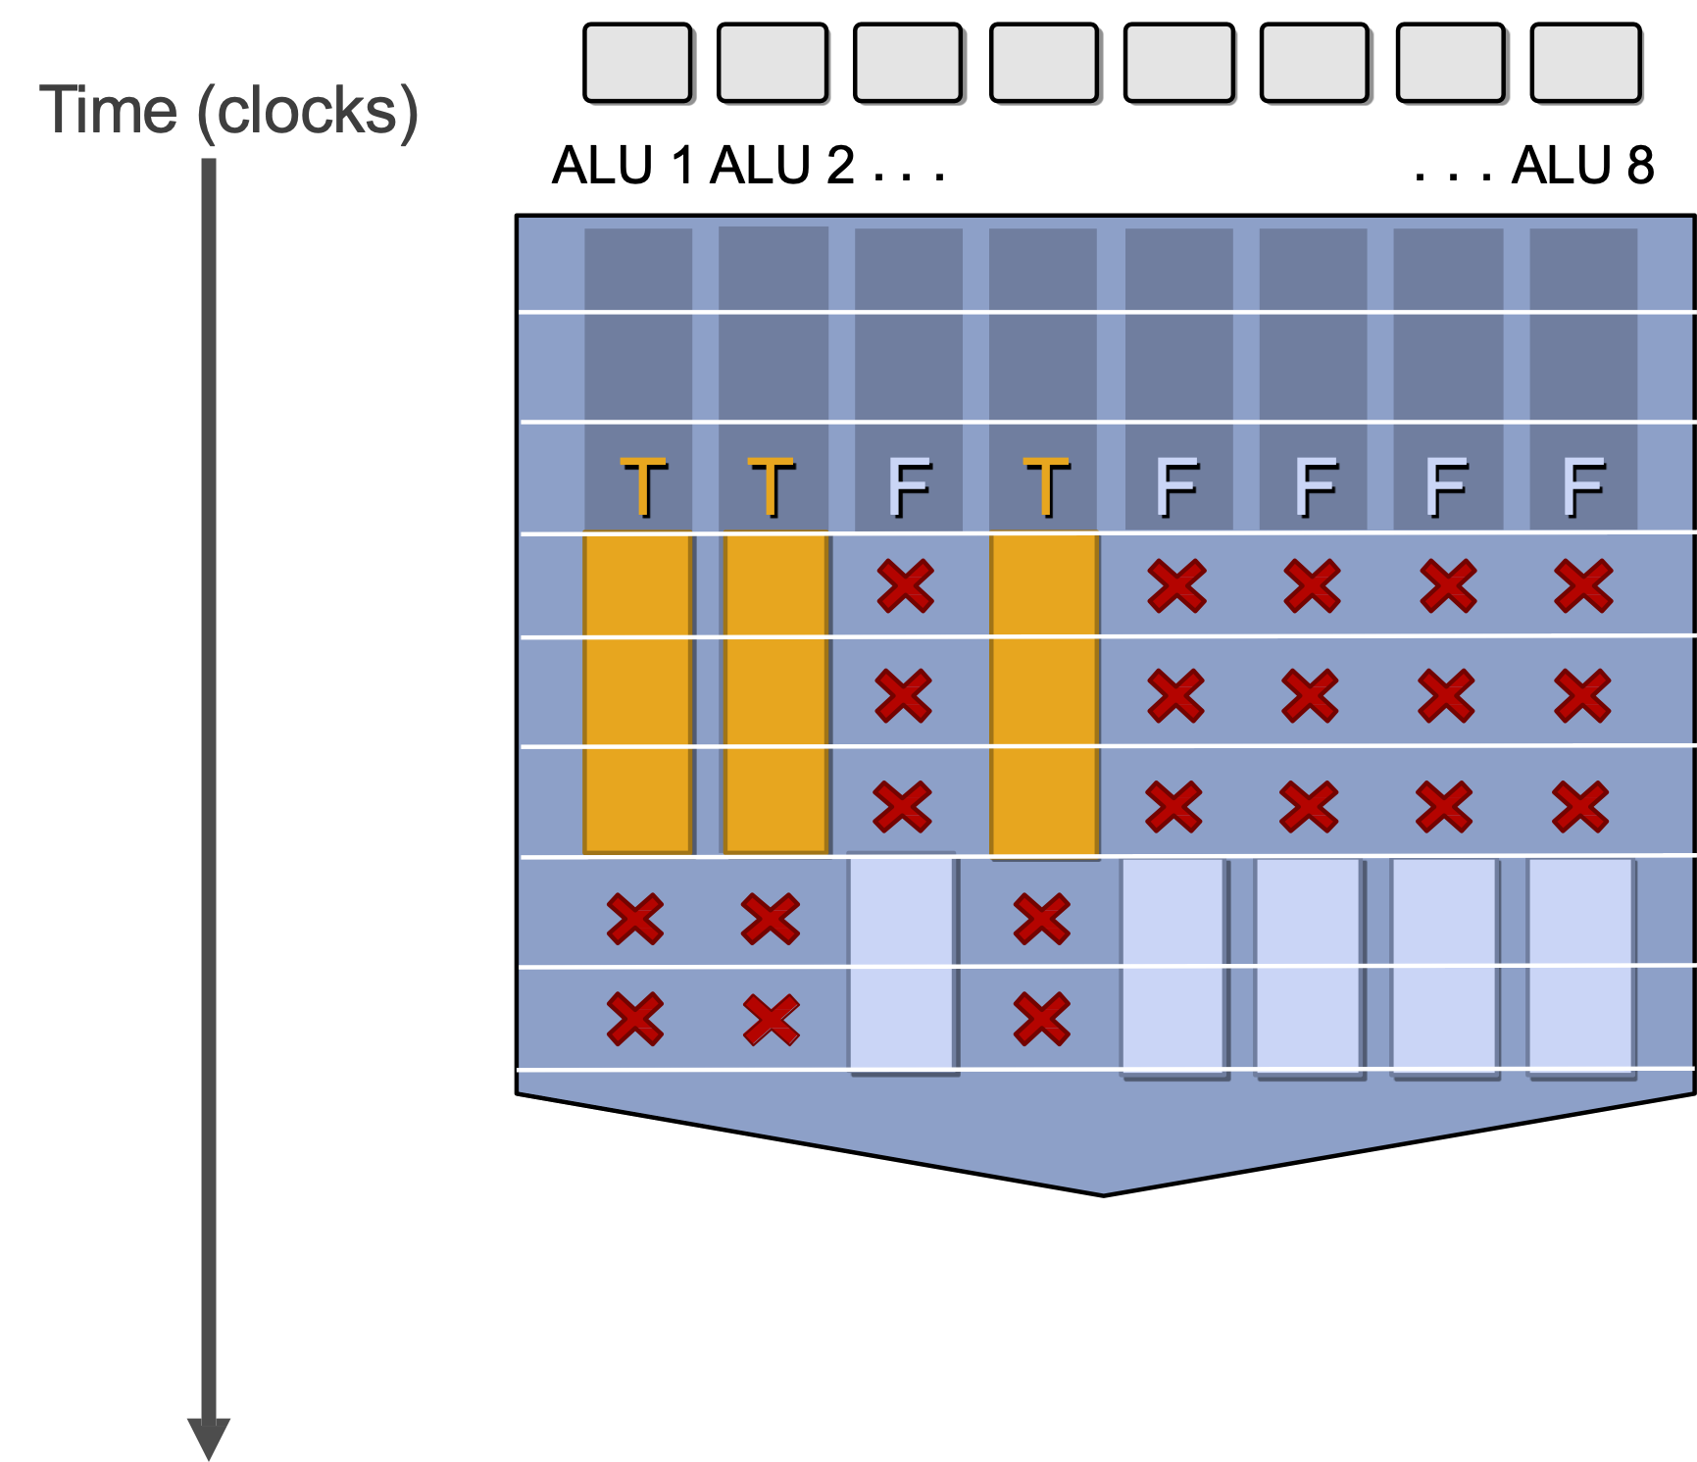
What about Branches?
<unconditional shader code>
if (x > 0) {
y = pow(x, exp);
y *= Ks;
refl = y + Ka;
} else {
x = 0;
refl = Ka;
}
<resume unconditional shader code>
Not all ALUs do useful work!
Worst case: 1/8 peak performance

Slide 21
Terminology
Instruction stream coherence (“coherent execution”)
Same instruction sequence applies to all elements operated upon simultaneously
Coherent execution is necessary for efficient use of SIMD processing resources
Coherent execution IS NOT necessary for efficient parallelization across cores, since each core has the capability to fetch/decode a different instruction stream
“Divergent” execution
A lack of instruction stream coherence

Slide 22
SIMD Execution on Modern GPUs
“Implicit SIMD”
Compiler generates a scalar binary (scalar as opposed to vector instructions)
But N instances of the program are *always running* together on the processor i.e., execute(my_function, N) // execute my_function N times
Hardware (not compiler) is responsible for simultaneously executing the same instruction on different data in SIMD ALUs
SIMD width in practice
32 on NVIDIA GPUs (a warp of threads) and 64 on AMD GPUs (wavefront)
Divergence can be a big issue (poorly written code might execute at 1/32 the peak capability of the machine!)

Slide 23
Dealing with Stalls on In-order Cores
Stalls occur when a core cannot run the next instruction because of a dependency on a previous long-latency operation
We’ve removed fancy logic that helps avoid stalls
No more out-of-order execution to exploit instruction-level parallelism (ILP)
Traditional cache doesn’t always help since a lot of workloads are streaming data
But, we have a LOT of parallel work…
Idea #3: Interleave processing of many warps on a single core to avoid stalls caused by high-latency operations

Slide 24
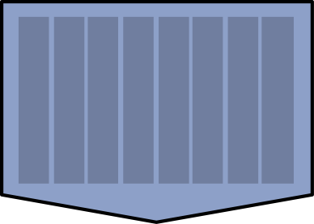
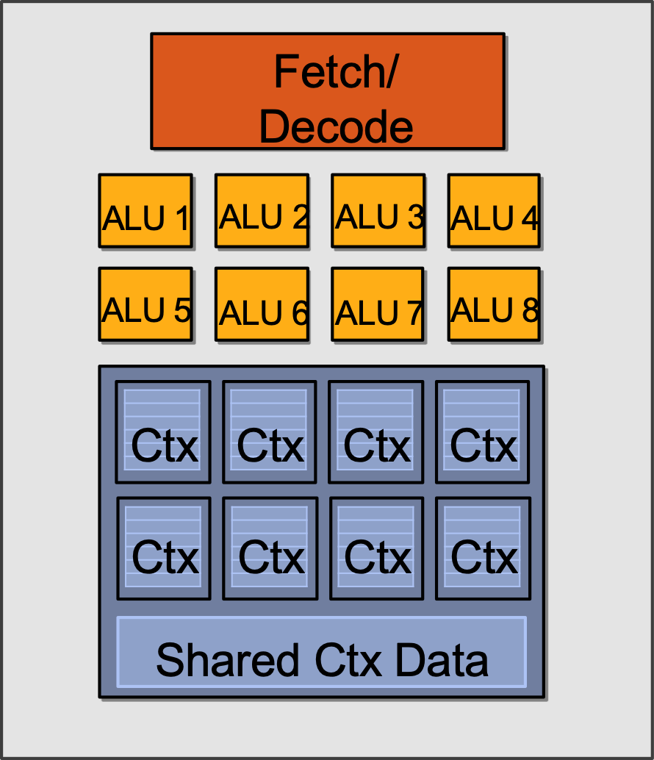
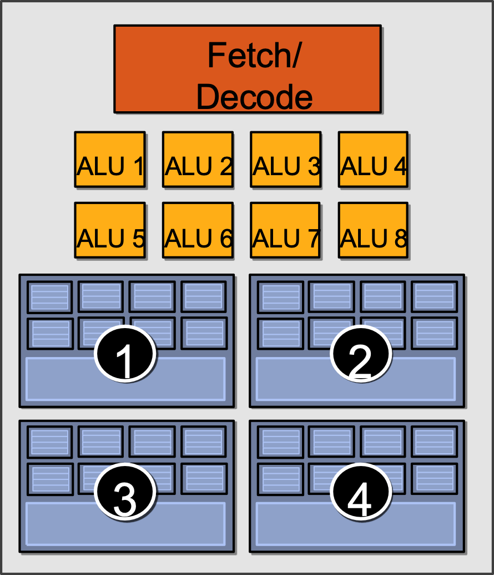
Hiding Stalls
Time
(clock cycles)
Element 1…8
Element 9…16
Element 17…24
Element 25…32
1
2
3
4

Slide 25
Hiding Stalls
Time
(clock cycles)
Element 1…8
Element 9…16
Element 17…24
Element 25…32
1
2
3
4
Runnable

Slide 26
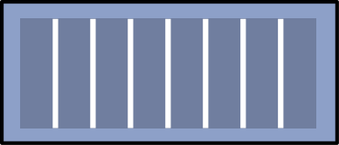
Hiding Stalls
Time
(clock cycles)
Element 1…8
Element 9…16
Element 17…24
Element 25…32
1
2
3
4
Runnable
Runnable
Done!
Runnable
Done!
Runnable
Done!
Done!

Slide 27
Throughput Computing Trade-off
Time
(clock cycles)
Element 1…8
Element 9…16
Element 17…24
Element 25…32
1
2
3
4
Runnable
During this time, this group is runnable, but it is not being executed by the processor. (The core is running some other group.)
Done!
Key idea of throughput-oriented systems:
Potentially increase runtime of one group, in order to increase throughput of overall system running multiple groups.

Slide 28
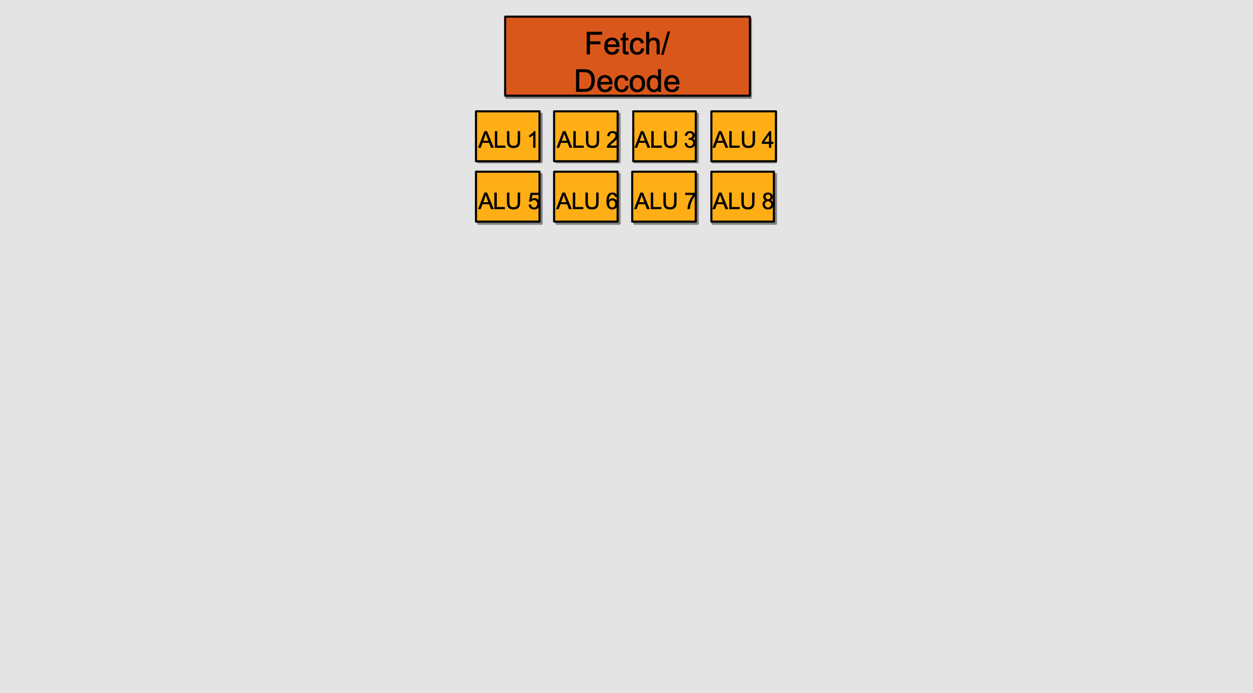
Storing Execution Contexts
Consider on-chip storage of execution contexts a finite resource
Resource consumption of each thread group is program-dependent
Execution Context Storage

Slide 29
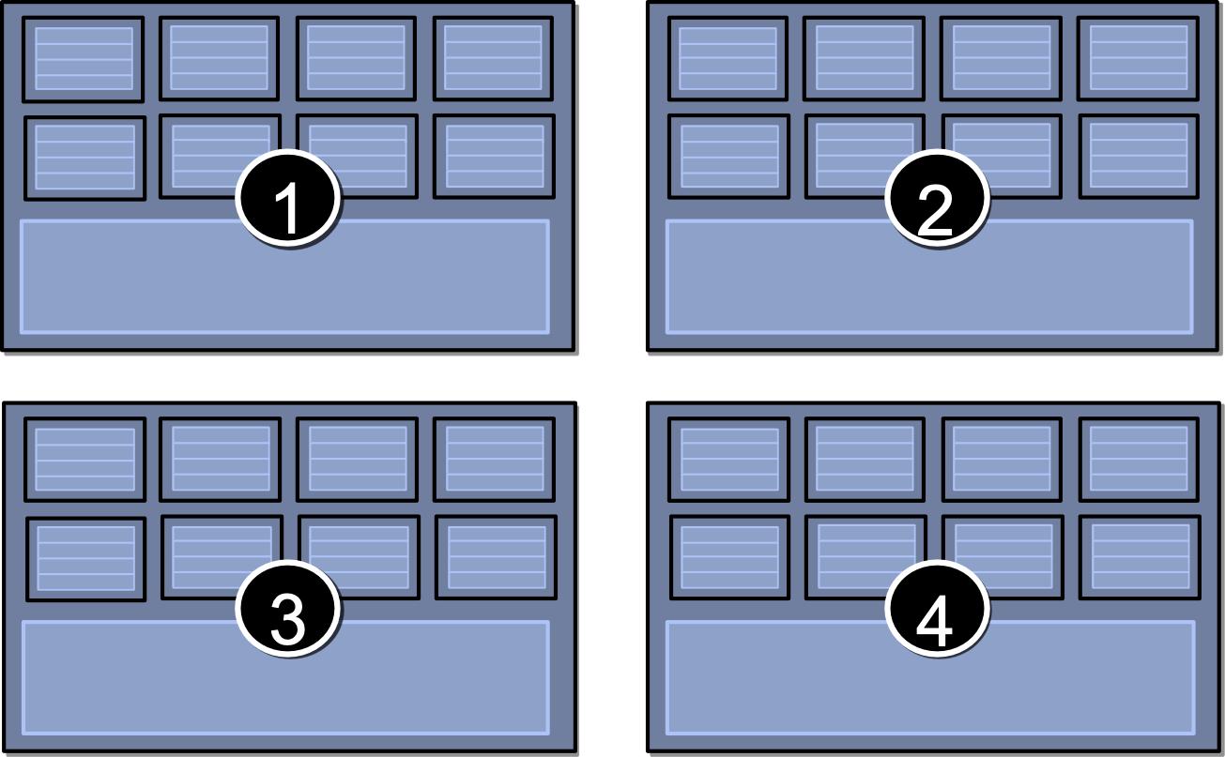
Four Large Contexts (Low Latency Hiding)

Slide 30
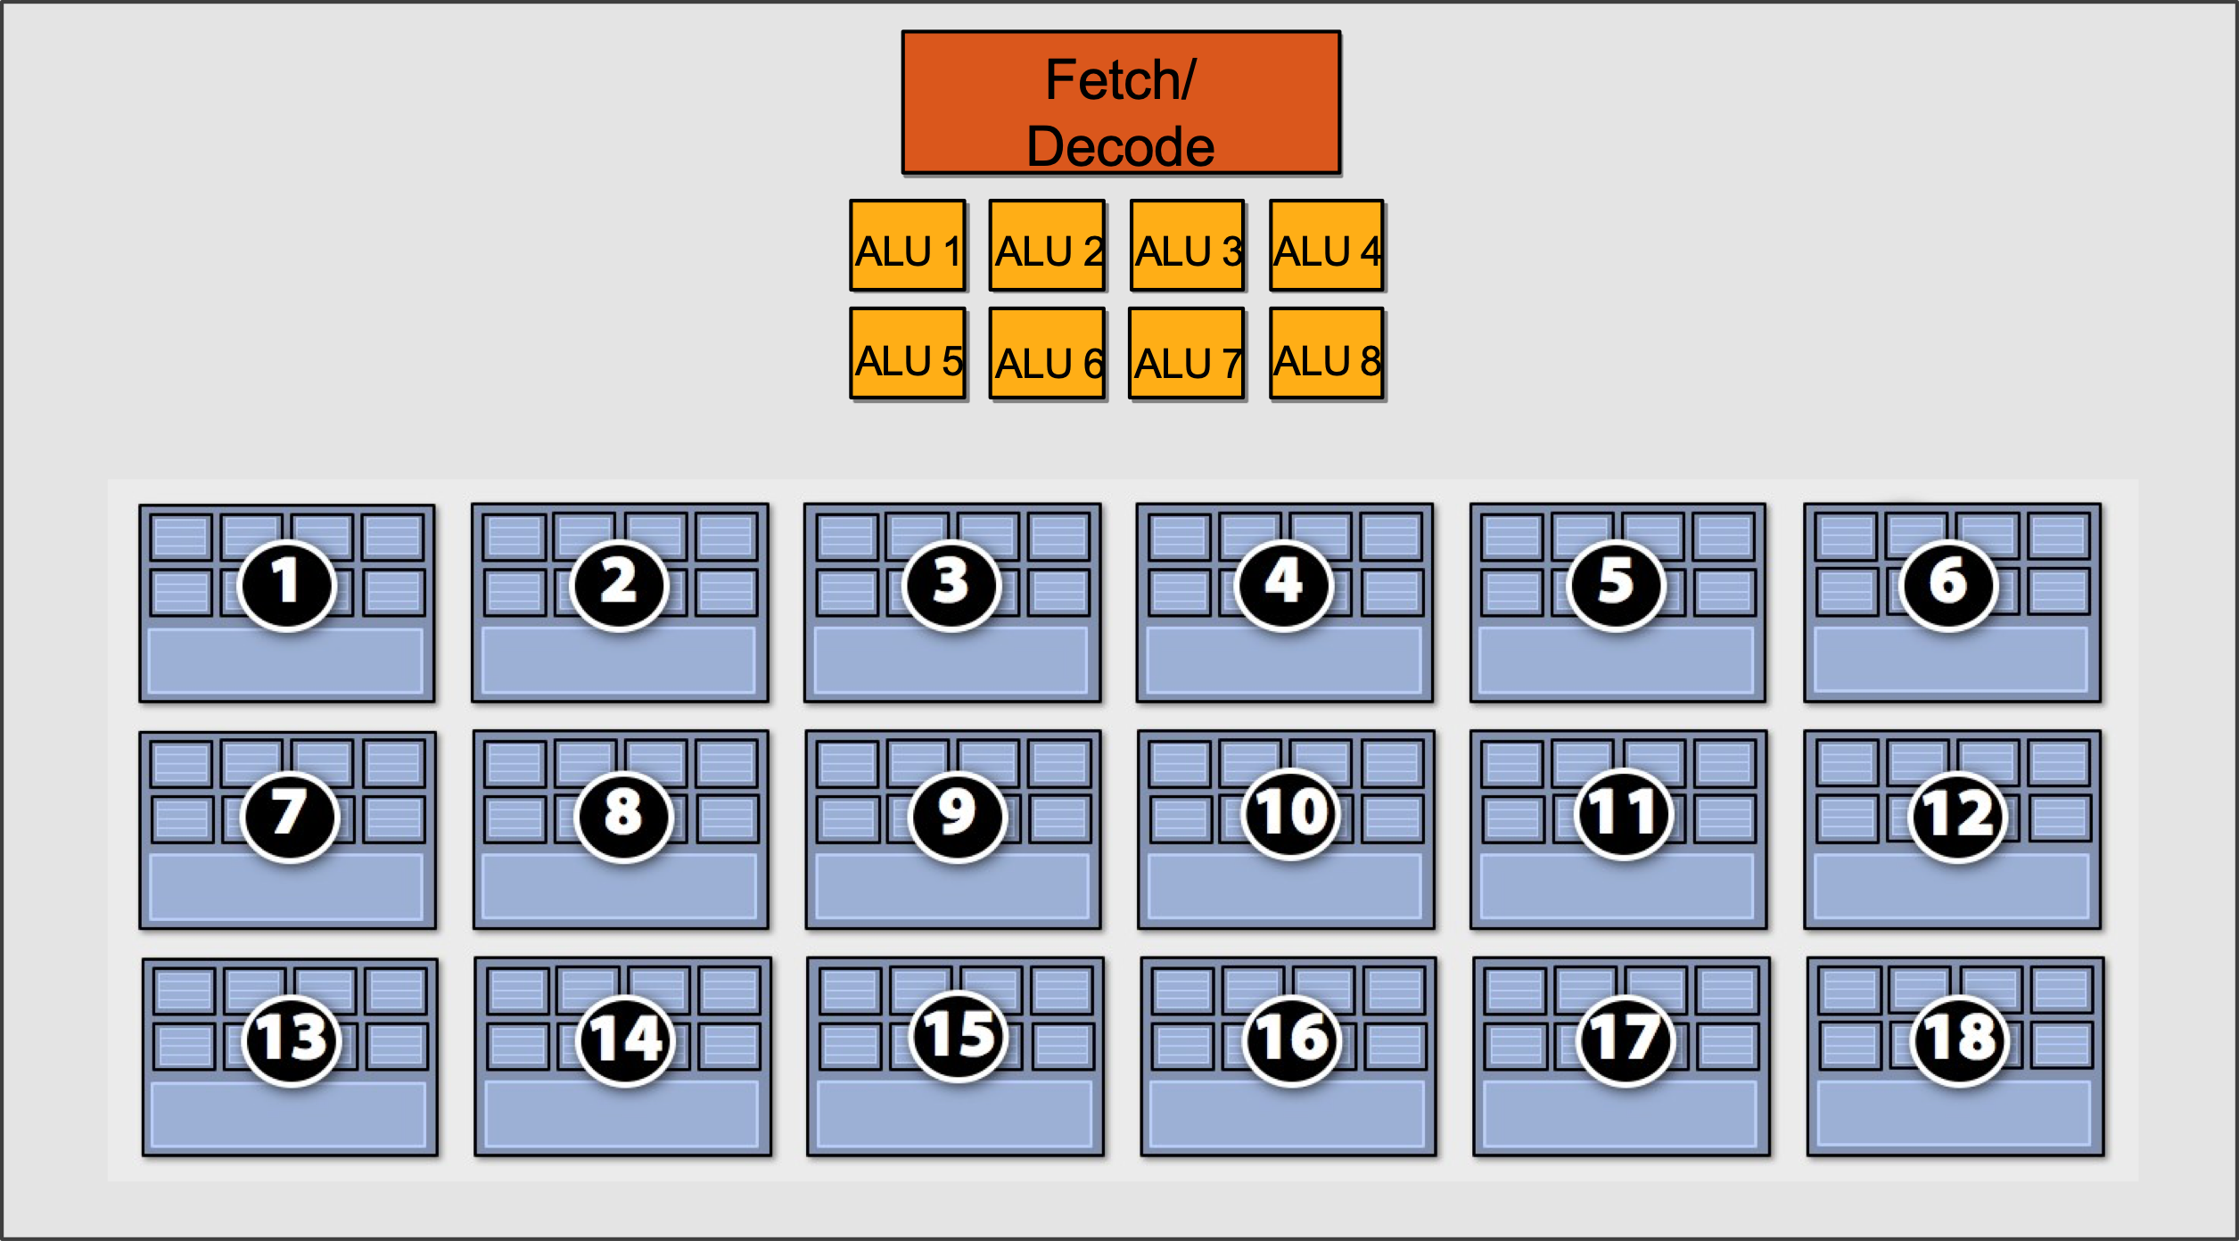
Eighteen Small Contexts (High Latency Hiding)

Slide 31
Summary: Three Key Ideas
Use many “slimmed down cores” to run in parallel
Pack cores full of ALUs (by sharing instruction stream on multiple data)
Avoid latency stalls by interleaving execution of many groups of threads
When one group stalls, work on another group

Slide 32
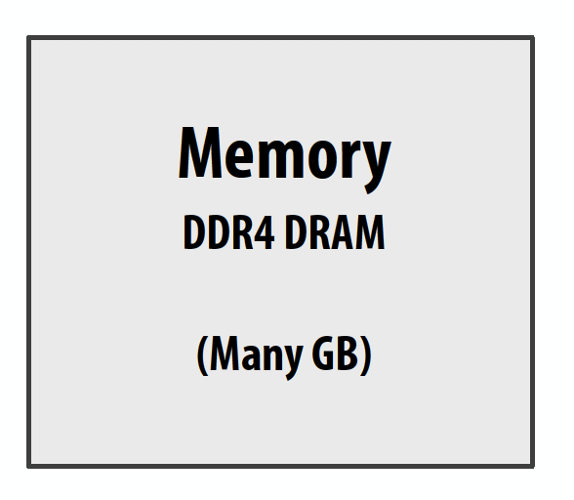
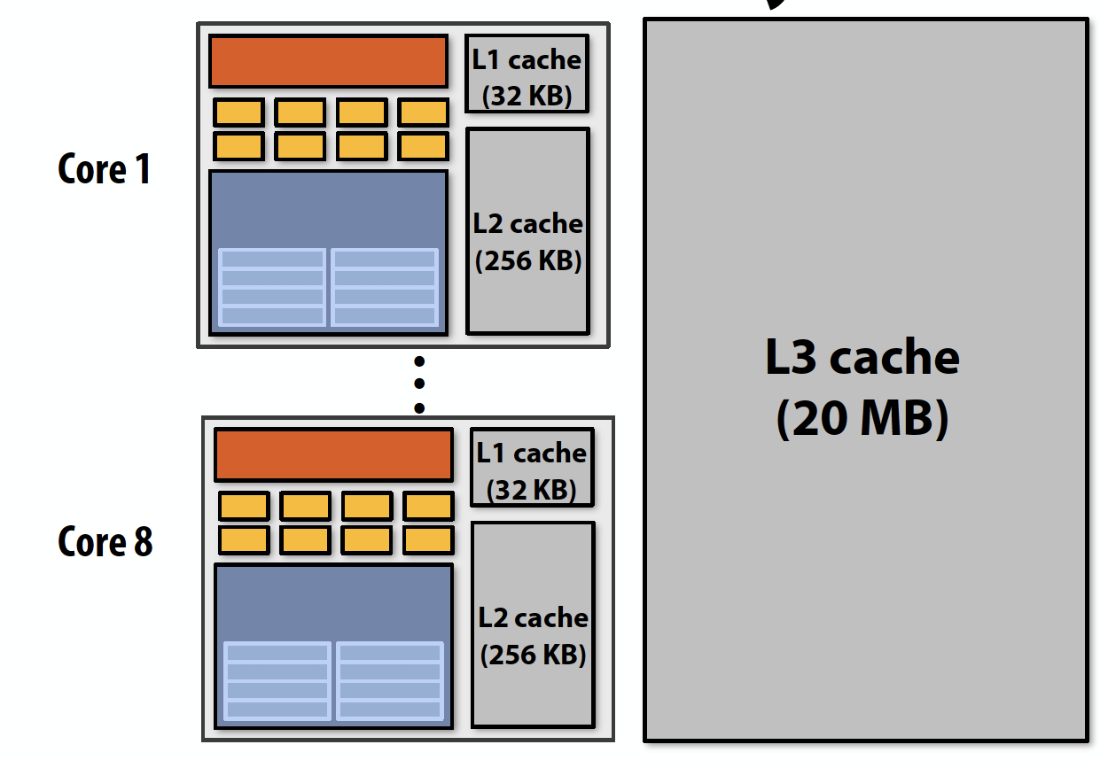
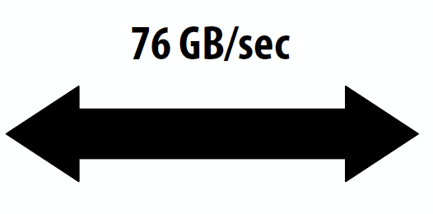
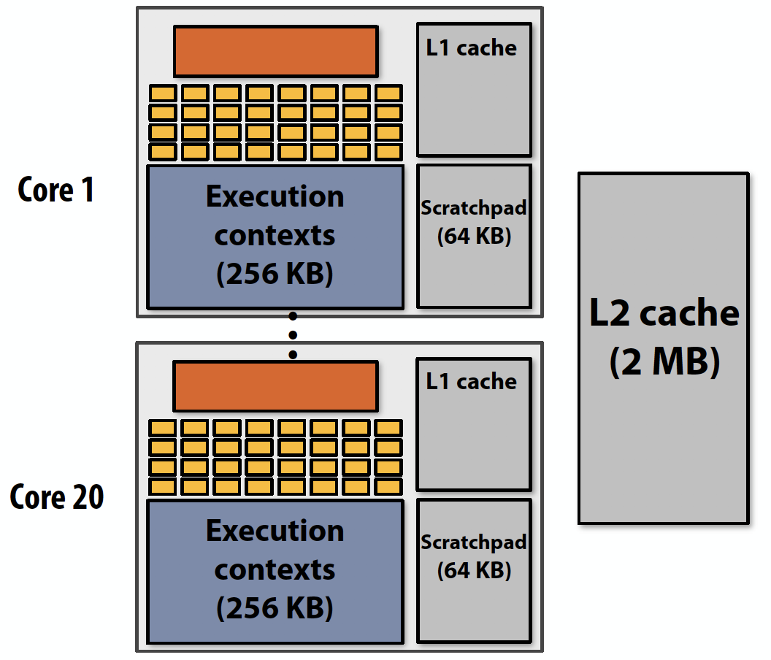
CPU v.s. GPU Memory Hierarchies
CPU:
Big caches, few threads per core, modest memory BW
Rely mainly on caches and prefetching
GDDR5
NVIDIA GTX 1080
(Pascal)
GPU:
Small caches, many threads, huge memory BW
Rely heavily on multi-threading for performance

Slide 33
Thought Experiment
Consider element-wise multiplication of two vectors a and b
Assume vectors contain millions of elements
Load input a[i]
Load input b[i]
Compute a[i] 𝘅 b[i]
Store result into v[i]
Three memory operations (12 bytes) for every MUL
NVIDIA GTX 1080 GPU can do 2560 MULs per clock (@ 1.6 GHz)
Need ~45 TB/sec of bandwidth to keep functional units busy (only have 320 GB/sec)
a
𝘅
b
=
v
<1% GPU efficiency… but 4.2x faster than eight-core CPU in lab!
(3.2 GHz Xeon E5v4 eight-core CPU connected to 76 GB/sec memory bus will exhibit ~3% efficiency on this computation)

Slide 34
Bandwidth limited!
If processors request data at too high a rate, the memory system cannot keep up.
No amount of latency hiding helps this.
Overcoming bandwidth limits are a common challenge for
application developers on throughput-optimized systems.

Slide 35
Bandwidth is a Critical Resource
Performant parallel programs will:
Organize computation to fetch data from memory less often
Reuse data previously loaded by the same thread
Share data across threads through scratchpad (inter-thread cooperation)
Access contiguous memory within the same warp (hardware managed memory coalescing)
Request data less often (instead, do more arithmetic: it’s “free”)
Useful term: “arithmetic intensity” — ratio of math operations to data access operations in an instruction stream
Main point: programs must have high arithmetic intensity to utilize modern processors efficiently

Slide 36
Memory Spaces in GPU
On-chip:
Register file
Usage determined by compiler
Spills go to local memory
Shared memory, i.e. scratchpad
Programmer managed
Bank conflicts
L1 cache
SM 1
SM n
Compute Cores
SM 0
Register File (fast)
Shared Memory (med)
L1 Cache (Slow)
…
Per thread
Per thread block
All resident threads
Off-chip:
L2 cache
Bandwidth filter for DRAM rather than reducing latency as in CPUs
Device memory (DRAM)
Several spaces: global memory, texture memory, local memory
Different spaces have different caching policies
L2 Cache (slow+)
Device Memory (slow++)

Slide 37
Modern GPU Architecture (Volta 2017)
21B transistors 815 mm²
80 SM
5120 CUDA Cores
640 Tensor Cores
16/32 GB HBM2
900 GB/s HBM2
300 GB/s NVLink
*full GV100 chip contains 84 SMs
37

Slide 38
Review #7
GPUs and the Future of Parallel Computing Steve Keckler et al., IEEE Micro 2011
Due Nov. 11

Slide 39
CSC 2224: Parallel Computer Architecture and Programming GPU Architecture: Introduction
Prof. Gennady Pekhimenko
University of Toronto
Fall 2019
The content of this lecture is adapted from the slides of Kayvon Fatahalian (Stanford), Olivier Giroux and Luke Durant (Nvidia), Tor Aamodt (UBC) and Edited by: Serina Tan

